Slide 1
EQ101 review - 1

Slide 2
Native EQUELLA
Insert image of native equella
Notes:
Two ways of accessing (viewing) EQUELLA –
Native EQUELLA that is accessed using a browser and URL.
Through an integrated presentation application LMS such as Blackboard, Moodle

Slide 3
Integrated EQUELLA
Insert image of integrated equella
EQU
Notes:
LMS = Blackboard , Moodle etc (write on the board - use as per institution)
They deliver the content

Slide 4
Digital content and EQUELLA
Digital content
Individual files, multi-file archives, learning objects, linked content.
Metadata
Information about content
EQUELLA resources
The fundamental EQUELLA entity
EQUELLA collections
The storage units that house resources
EQUELLA institutions
The whole repository

Slide 5
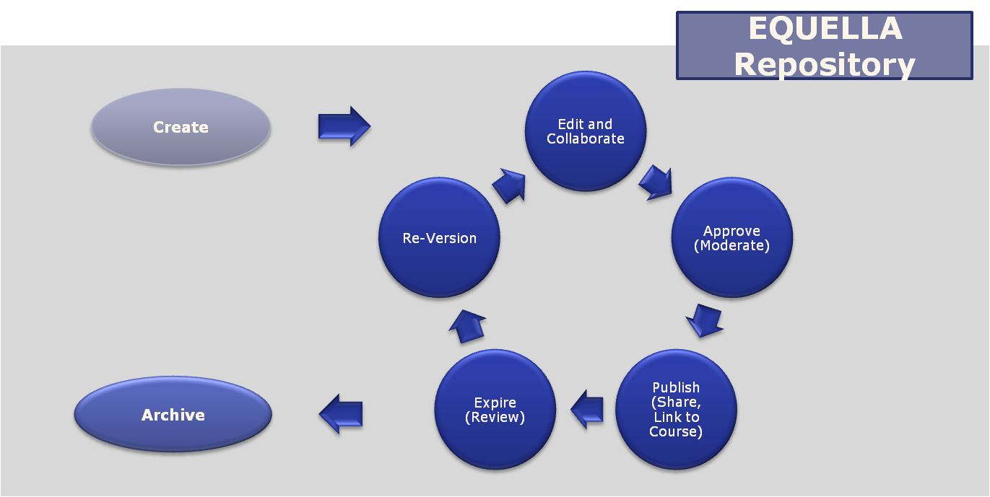
EQUELLA resource lifecycle

Slide 6
How does EQUELLA work?
Every resource that enters the repository is catalogued:
resource metadata
Users are provided with suitable permissions to:
search, view, create, manage, administer
Searches use the resource metadata to find results
Resources and their components can then be linked to courses.

Slide 7
Anatomy of an EQUELLA Repository
EQUELLA Institution
Multiple Collections
Collection
Workflow
Resources
Content
Metadata
Multiple Resources
Contribution Wizard
Security
User Management
Security
Unique URL
Administration Console
Metadata Schema

Slide 8
EQUELLA’s Universe
EQUELLA frees content from the bounds of its repository:
Shared interfaces and metadata standards
Copyright management
Digital rights management.
Content can be federated, harvested or linked to or from
external sources:
Other EQUELLA institutions
External repositories that implement industry accepted standards and protocols.
Notes:
EQUELLA provides:
External application interfaces
metadata standards
Copyright management
DRM

Slide 9
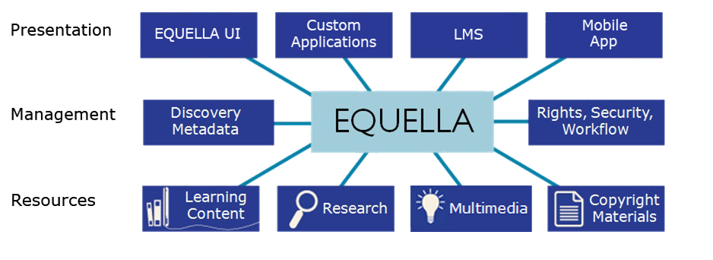

EQUELLA architecture
Upload, search and use:
Files (Word, Excel, PDF, ZIP), multimedia (movies, audio), images, Web links, YouTube videos, Google Books, iTunesU tracks, Flickr images, Kaltura media, eBooks, journals, Echo360 lectures, LTI, learning objects (IMS, SCORM, QTI, METS) and internal links to resources, files and webpages

Slide 10
Common Uses for EQUELLA
LMS Integration(s)
Content tagged to standards and/or taxonomies
Image data base
Research Repository
Library System Integration
Federated Searching
DRM/Copyright
Course/Content Production
Student ePortfolio
Open Educational Resources / Open Courseware
And more...

